Slide 1
Research in the field of artificial intelligence conducted by lab 4.2 ISDCT SB RAS
Yurin A.Yu.

Slide 2
Main areas of research
ISDCT SB RAS <number>
Knowledge representation, acquisition and processing;
Development of tools for AI methods and systems;
Development of knowledge-based systems (ES, DSS);
Agent-based simulation.

Slide 3
Research specifics
ISDCT SB RAS <number>
Orientation on end-users (non-programmers);
Use of domain-specific languages (DSL);
Visual programming;
Automated source codes and specification generation;

Slide 4
Main tasks
ISDCT SB RAS <number>
Development of AI methods.
Development of software tools for AI systems.
Development of expert systems and intelligent decision support systems.

Slide 5
Main results: Methods
ISDCT SB RAS <number>
Specialized notation for visual modeling of logical rules - Rule Visual Modeling Language (RVML).
An approach for prototyping expert systems based on the principles of model-driven approach.
A language for describing model transformations - Transformation Model Representation Language (TMRL).

Slide 6
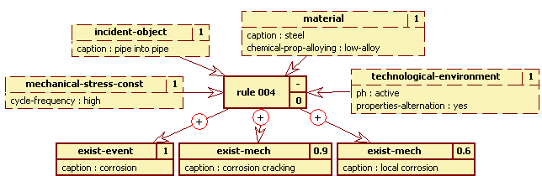
Rule Visual Modeling Language
ISDCT SB RAS <number>
(defrule rule_004 ""
(mechanical-stress-const (cycle-frequency "HIGH") (cf "1") )
(technological-environment (ph "ACTIVE") (properties-alternation "YES")
(cf "1")
) …
Yurin A.Yu., Dorodnykh N.O., Nikolaychuk O.A., Grishenko M.A. Designing rule-based expert systems with the aid of the model-driven development approach // Expert Systems, 2018, Vol. 35, No. 5, P. 1-23.

Slide 7
ISDCT SB RAS <number>
An approach for prototyping expert systems
Using models of varying degrees of abstraction;
Sequential transformation (transformation) of models in order to obtain source codes and specifications;
Use of specialized notations to describe knowledge representation formalisms.
Yurin A.Yu., Dorodnykh N.O., Nikolaychuk O.A., Grishenko M.A. Prototyping Rule-Based Expert Systems with the Aid of Model Transformations // Journal of Computer Science, 2018, 14 (5): 680-698.

Slide 8
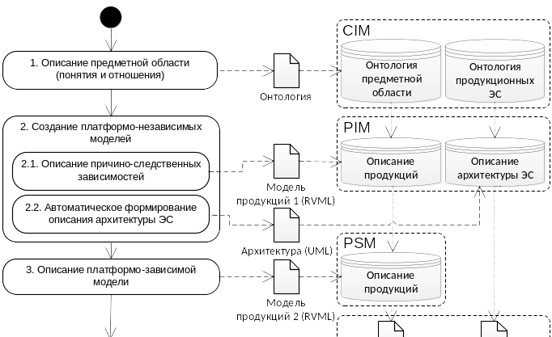
ISDCT SB RAS <number>
An approach for prototyping expert systems

Slide 9
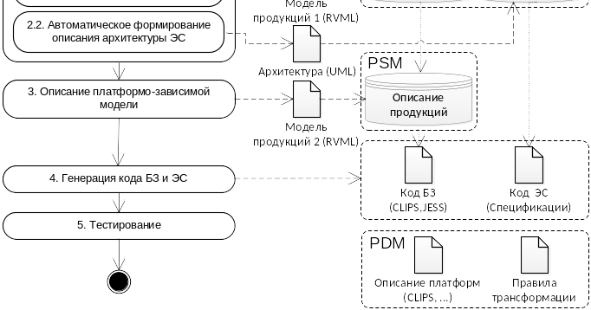
ISDCT SB RAS <number>
An approach for prototyping expert systems

Slide 10
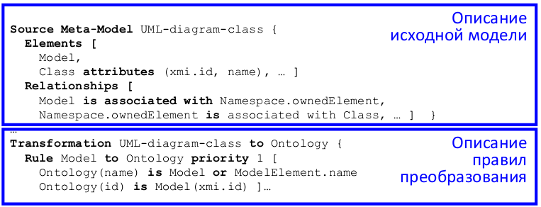
Transformation Model Representation Language
ISDCT SB RAS <number>
Yurin A.Yu., Dorodnykh N. O. A domain specific language for transformation models Information. Technologies: Algorithms, Models, Systems
Proceedings for First Scientific-practical Workshop Information Technologies: Algorithms, Models, Systems (ITAMS). Irkutsk, Russia, September 5, 2018. (CEUR-Proc, Vol. 2221) p.70-75.

Slide 11
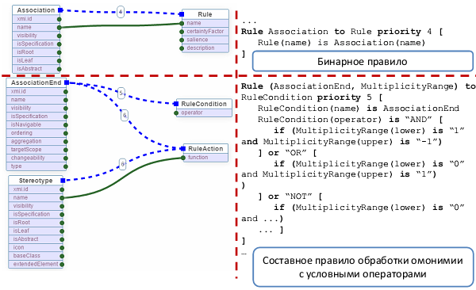
Transformation Model Representation Language
ISDCT SB RAS <number>

Slide 12
Main results: software tools
ISDCT SB RAS <number>
Software tool for prototyping knowledge bases of rule-based expert systems – Personal Knowledge base designer (PKBD).
Web-based tool for knowledge base creation on the basis of conceptual model transformation - Knowledge Base Development System (KBDS).
A multi-component tool for building knowledge-based systems.
Tool prototyping systems for agent-based simulation.

Slide 13
Personal Knowledge Base Designer
ISDCT SB RAS <number>
Main functions:
- knowledge base management;
- logical inference;
- support of “domain-specific editor" mode;
- support of RVML.
Yurin A.Yu., Dorodnykh N.O., Nikolaychuk O.A., Grishenko M.A. Designing rule-based expert systems with the aid of the model-driven development approach // Expert Systems, 2018, Vol. 35, No. 5, P. 1-23.

Slide 14
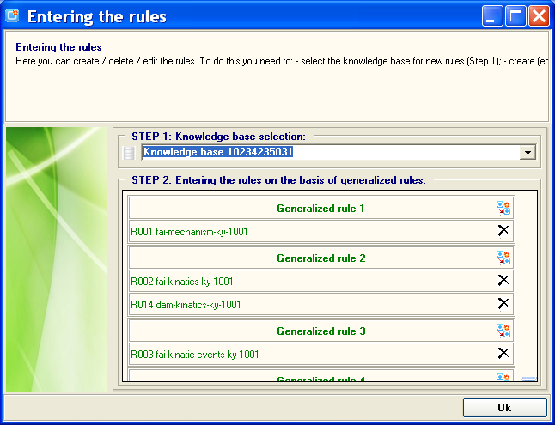
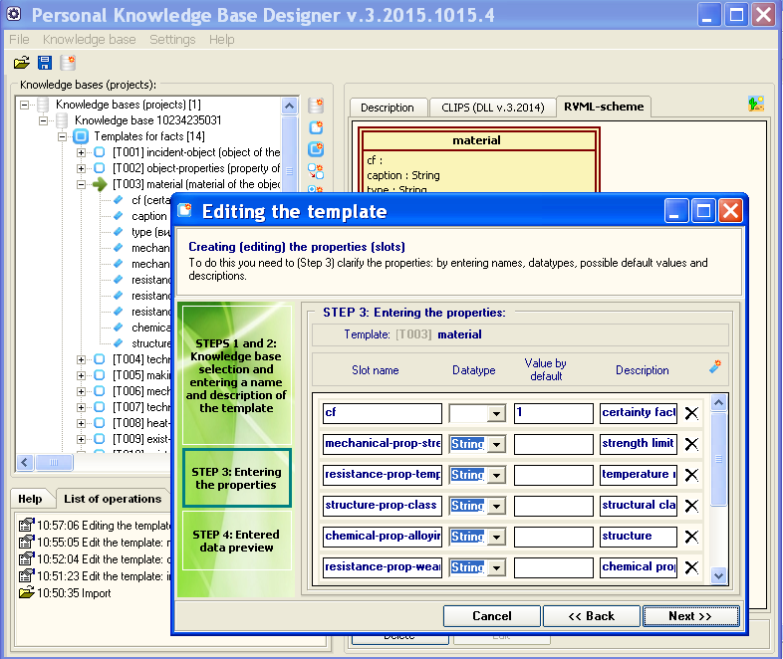
ISDCT SB RAS <number>
Personal Knowledge Base Designer
АС №№ 2016617733, 2012614093, 2007613714

Slide 15
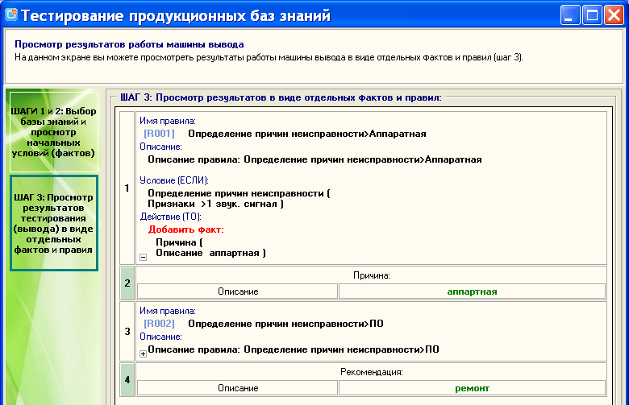
ISDCT SB RAS <number>
Personal Knowledge Base Designer

Slide 16
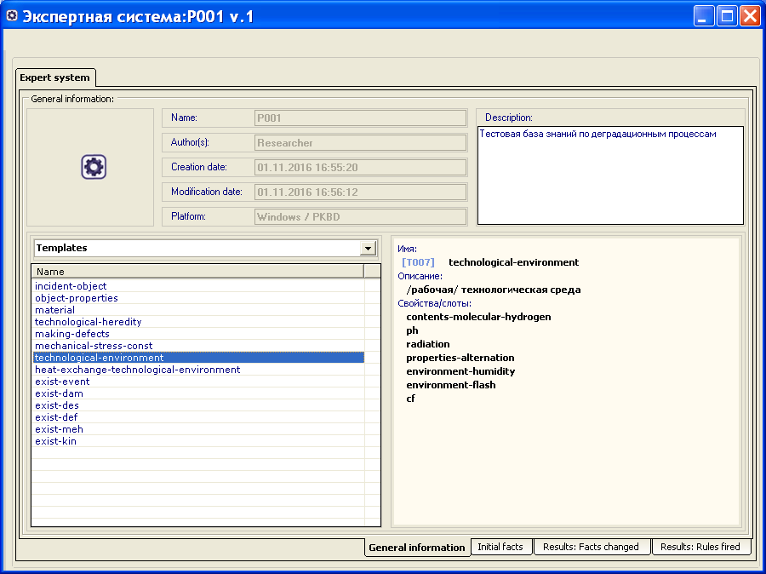
Институт динамики систем и теории управления им. В.М. Матросова СО РАН <number>
Тестирование базы знаний. Результаты логического вывода

Slide 17
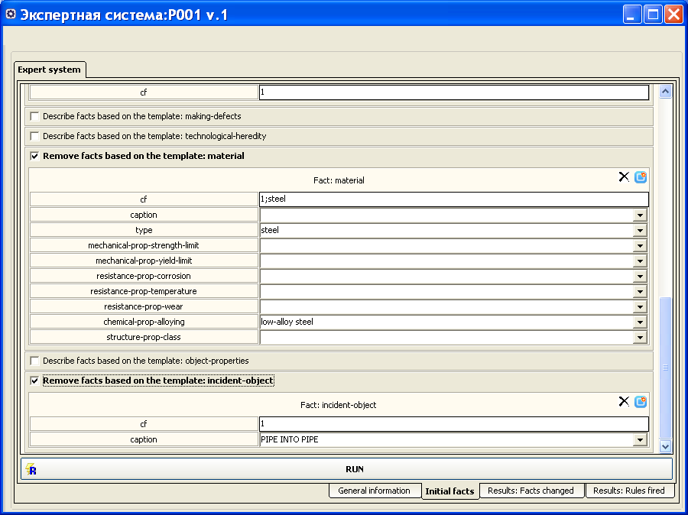
Институт динамики систем и теории управления им. В.М. Матросова СО РАН <number>
Тестирование базы знаний. Результаты логического вывода

Slide 18
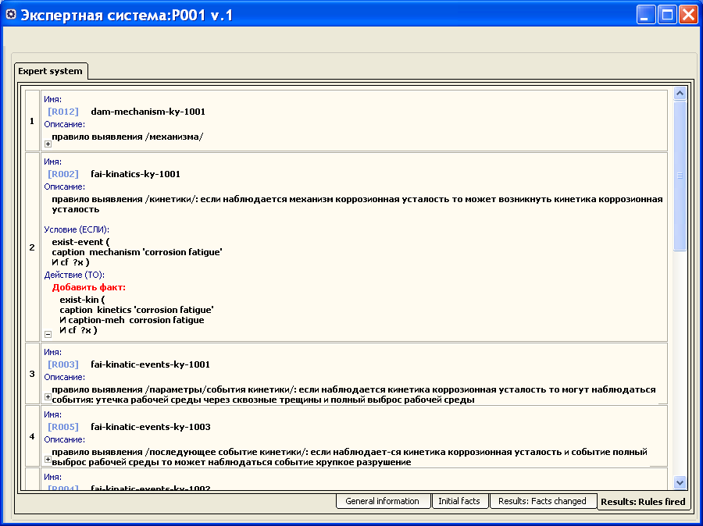
Институт динамики систем и теории управления им. В.М. Матросова СО РАН <number>
Тестирование базы знаний. Результаты логического вывода

Slide 19
Knowledge Base Development System
ISDCT SB RAS <number>
Main functions:
- visual construction of transformation models (rules of elements correspondence);
- support of TMRL;
- CLIPS codes generation;
- support of RVML;

Slide 20
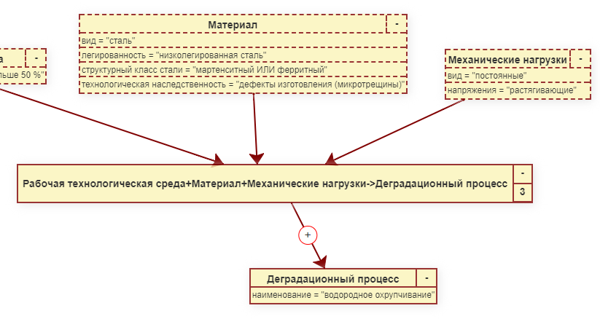
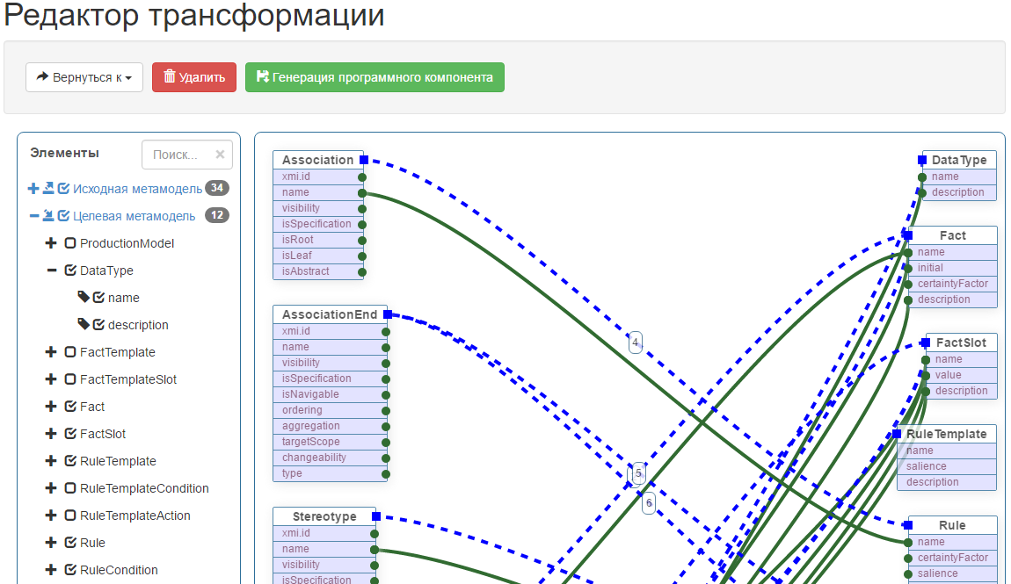
ISDCT SB RAS <number>
Knowledge Base Development System
АС №№ 2018660815, 2017618430 , 2017618446

Slide 21
A multi-component tool for building knowledge-based systems
ISDCT SB RAS <number>
Main functions:
- conceptual modeling;
- rule-bases modeling;
- DROOLS code generation;
- testing obtained codes;
- generation of GUI.
Nikolaychuk O.A., Pavlov A.I., Stolbov A.B. The software platform architecture for the component-oriented development of knowledge-based systems // MIPRO 2018. pp. 1064-1069.

Slide 22
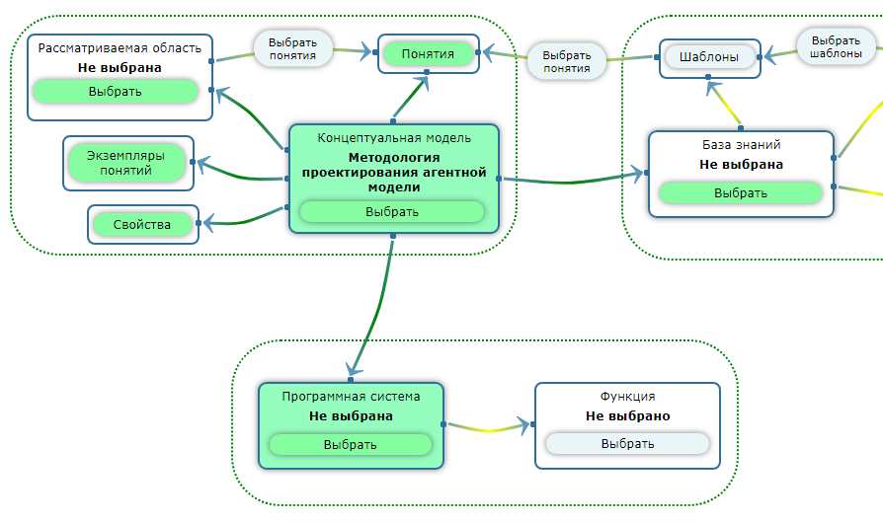
ISDCT SB RAS <number>
A multi-component tool for building knowledge-based systems
АС №№ 2016617626, 2016663618, 2017660160

Slide 23
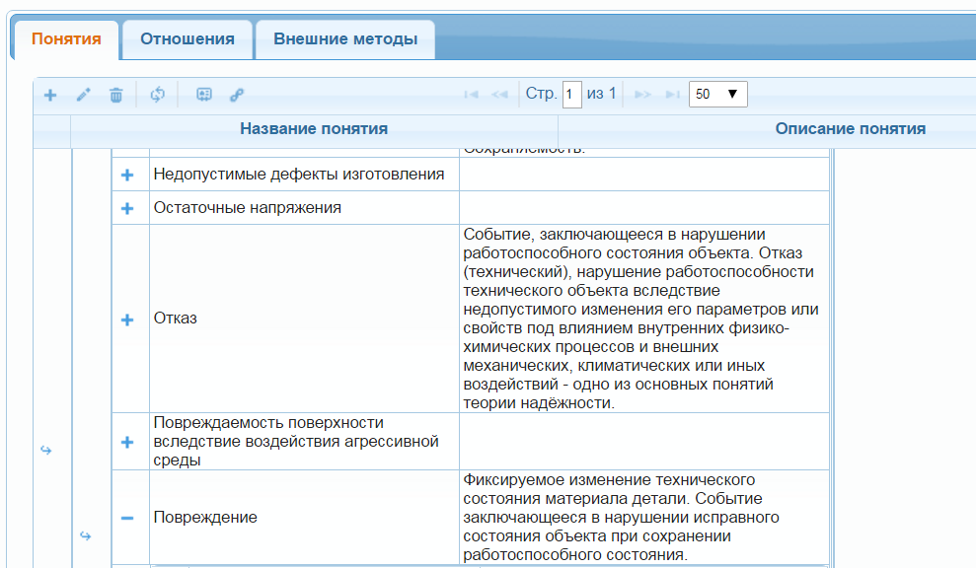
ISDCT SB RAS <number>
A multi-component tool for building knowledge-based systems

Slide 24
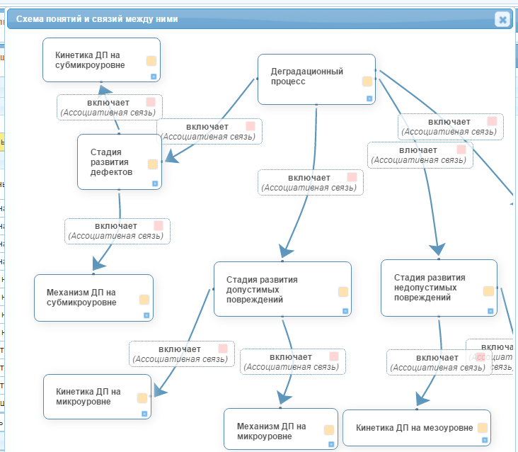
ISDCT SB RAS <number>
A multi-component tool for building knowledge-based systems

Slide 25
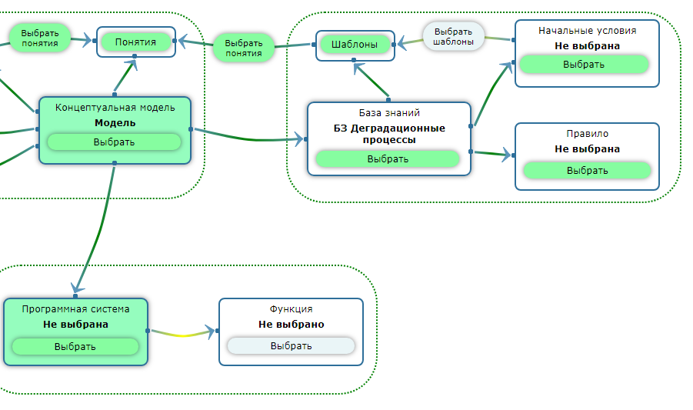
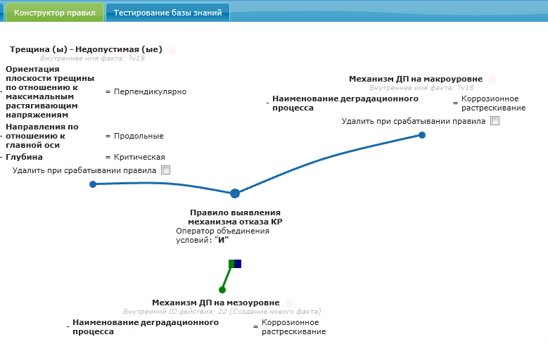
ISDCT SB RAS <number>
A multi-component tool for building knowledge-based systems

Slide 26
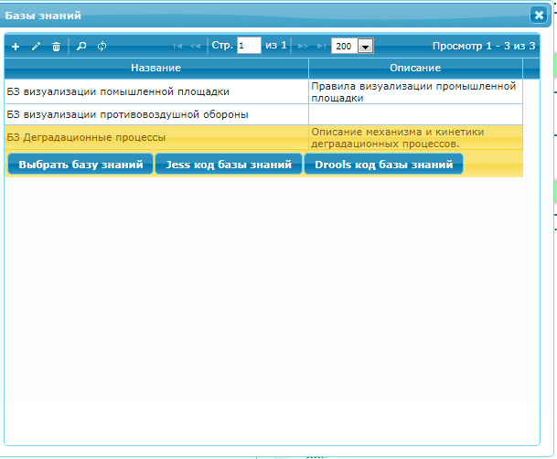
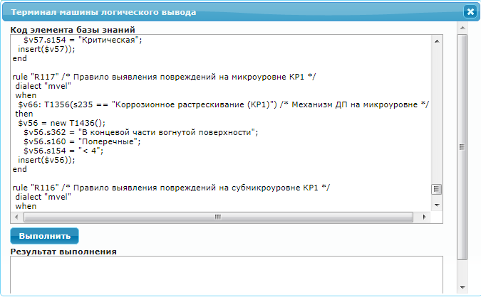
ISDCT SB RAS <number>
A multi-component tool for building knowledge-based systems

Slide 27
Research in the field of artificial intelligence conducted by lab 4.2 ISDCT SB RAS
ISDCT SB RAS <number>
Thanks!
Yurin A.Yu.

